Slide 1
ACRP – November 2024 Monthly Meeting

Slide 2
The South Carolina Republican Creed
I do not choose to be a common man. It is my right to be uncommon.
If I can seek opportunity, not security, I want to take the calculated risk to dream and build, to fail and to succeed. I refuse to barter incentive for dole.
I prefer the challenges of life to guaranteed security, the thrill of fulfillment to the stale calm of utopia.
I will not trade freedom for beneficence, nor my dignity for a handout.
I will never cower before any master, save my God.
It is my heritage to stand erect, proud and unafraid. To think and act for myself, enjoy the benefit of my creations; to face the whole world boldly and say, “I am a free American.”

Slide 3
WE WON!
Out with the OLD,
and into the GOLD.
We are forging the way into beautiful America’s GOLDEN age!
#goldenage

Slide 4
WINNERS FOR ANDERSON COUNTY
US 3rd Congressional District - Sheri Biggs
State Senator, District 3 - Richard J Cash
State Senator, District 4 - Mike Gambrell -
Republican State House Members: Thomas Beach (D10), April Cromer (D6), Lee Gilreath (D7), Don Chapman (D8), Blake Sanders (D9), Craig Gagnon (D11), *Chris Huff (D28)
County Council Members: James Davis (D6), Chris Sullivan (D1), Cindy Wilson (D7), Brett Sanders (D4), Tommy Dunn (D5), Greg Elgin (D3)
Anderson County Auditor - John Benca
Anderson County Coroner - Greg Shore
Anderson County Sheriff - Chad McBride
Anderson County Treasurer - Jason Phillips
10th Circuit Solicitor - Micah Black
School District Board Members: Troy Haguewood (D5, A1), Bill Thompson III (D5, At Large), Tripp Dukes (D5, A7)

Slide 5
NOW, WE WORK
By the time Trump is sworn in, know your elected servants in your state legislature and in Congress by names.
Follow them on social.
Have their office number saved in your phone
Pay attention to what they are championing and resisting.
Hold them accountable for the clear mandate sent by WE THE PEOPLE to MAKE AMERICA HEALTHY, SAFE, PROSPEROUS, AND GREAT AGAIN

Slide 6
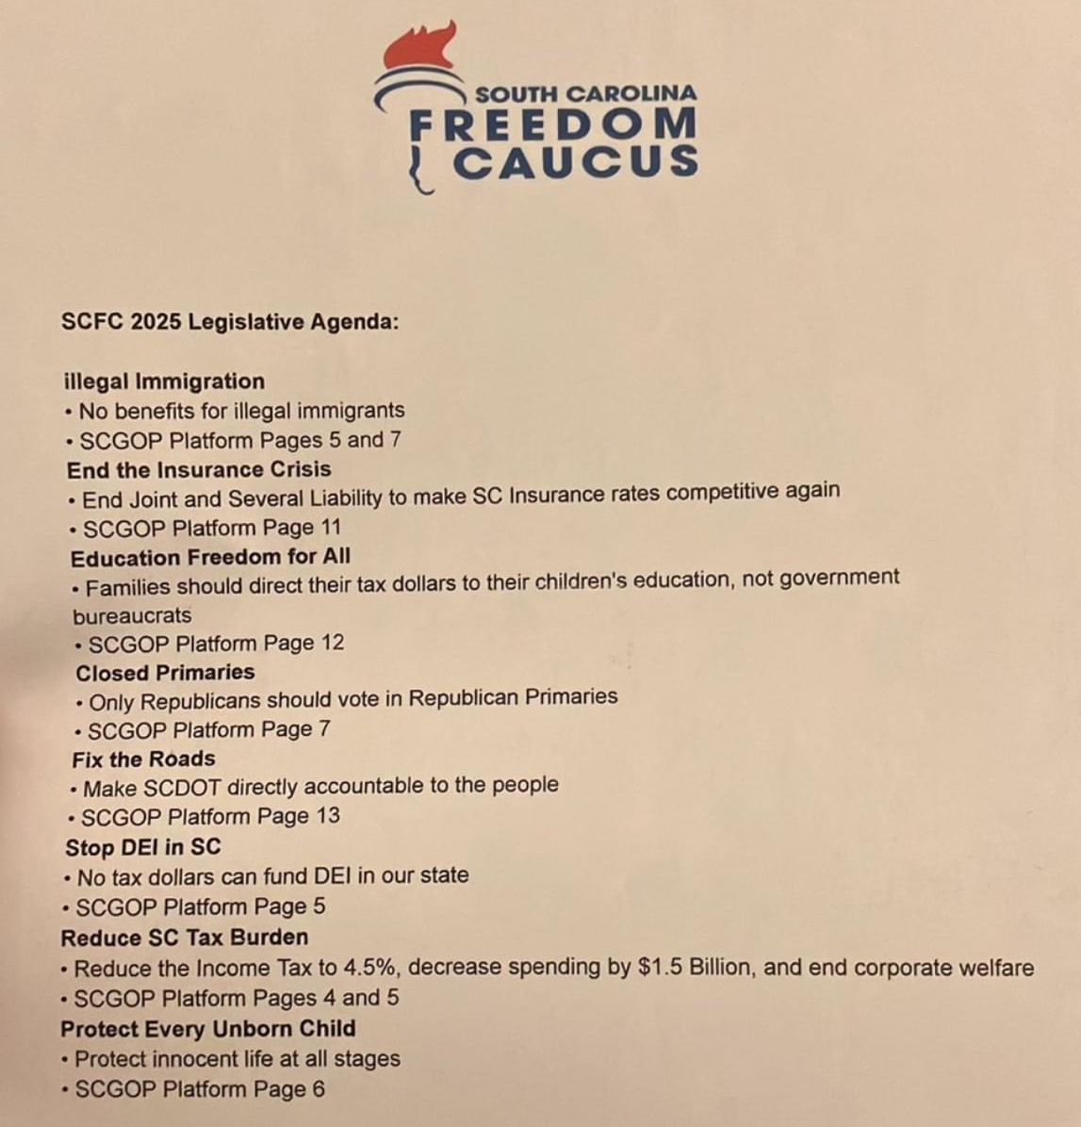

Slide 7
Upcoming Events:
LIVE MUSIC!
LIVE
ENTERTAINMENT!

Slide 8
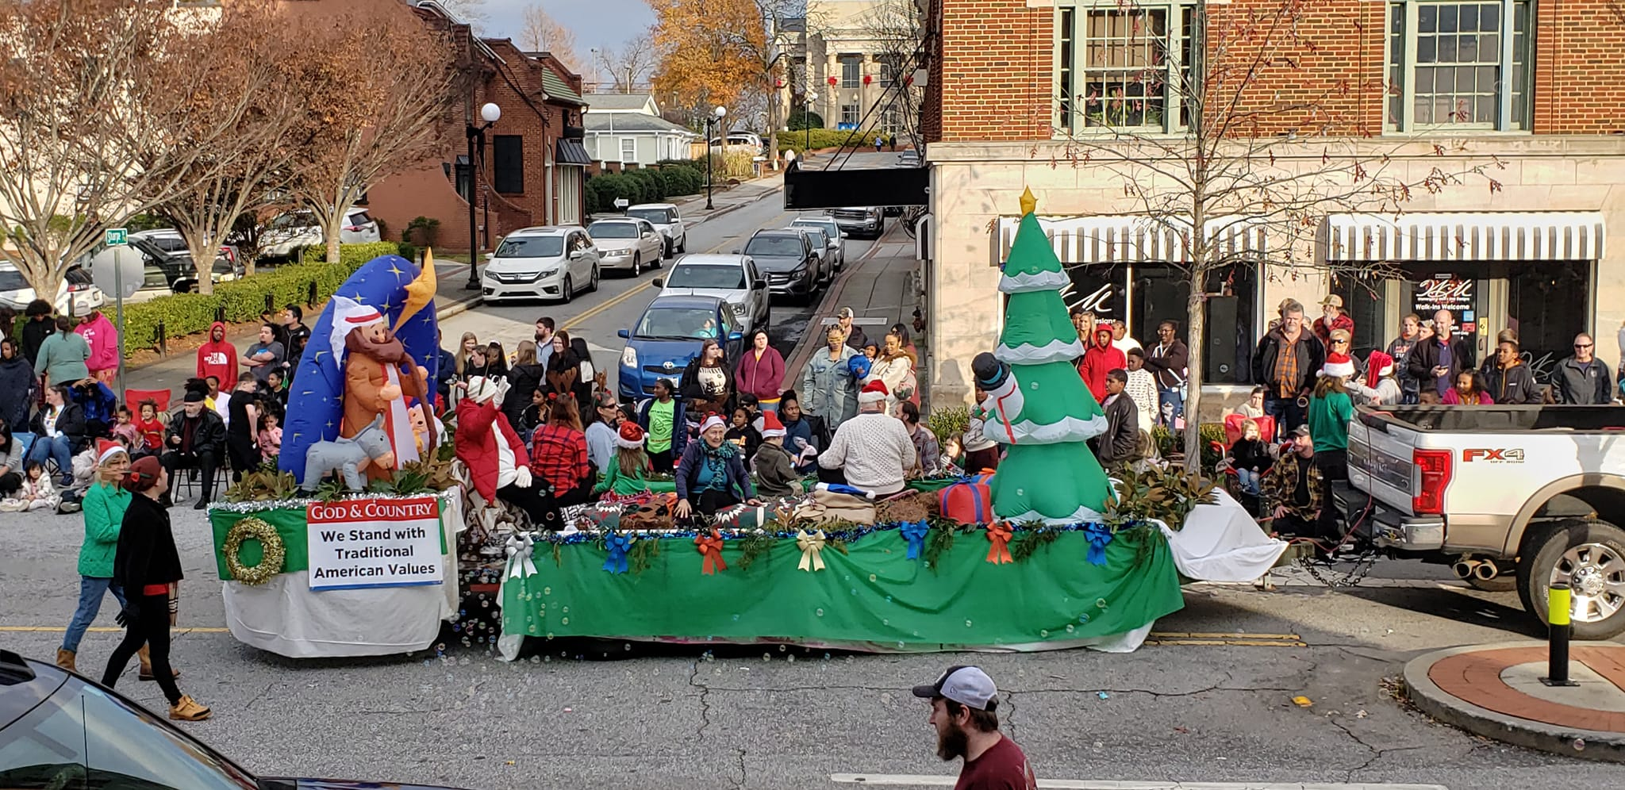
Upcoming Events:
Anderson Christmas Parade: December 8, 2024 @ 3pm
Contact David Rankin (864) 933-4426 or Sandra Rankin (864) 933-4399 for additional information

Slide 9
Now Presenting:
andersonsc.gop

Slide 10
Get Connected With Us!
@andersoncountysc_gop
Anderson County SC Republican Party
andersonscgop
@andersonscgop

